Slide 1
Bioinformatics 401
Giant Viruses

Slide 2
Giant Virus Paper Overview
24 of 65 surveyed chlorophyta genomes found to have GEVEs
GEVEs showed signs of genomic rearrangement pointing after endogenization indicative of horizontal gene transfer
Up to 10% of GEVEs not identified with eukaryotic gene prediction methods
Changes to Project Plan:
No longer studying the occurrence of GEVEs in other taxa
Notes:
The paper that we have chosen to replicate is the Widespread endogenization of giant viruses shapes genomes of green algae Moniruzzuman et al. (2020).
Giant viruses are of great interest due to their large genomes and complexity. This paper focus on whether they are a prominent component of eukaryotic endogenous viral elements. This paper reports that these viruses, in green algae at least, substantially increases the scale of known viral genes in eukaryotic genomes and a possible method for horizontal gene transfer in eukaryotes.
Many of the GEVEs showed indicative signs of genomic rearragements taking place after endogenization such as segmental duplication and gene loss. They also identified of numerous transposons in the giant viruses, as well as numerous spliceosomal introns in the chlorophyta genomes that were absent in their reference genomes but were present in various GEVE genes, indicating that the GEVEs facilitate horizontal gene transfer similar to other EVEs and that GEVEs represent bona fide component of algal genomes.
Moreover, Moniruzzuman et al. (2020) found that, in general, many of the viral genes identified in the giant endogenous viral elements, up to 10%, were not identified with standard eukaryotic gene prediction methods, concluding that GEVEs were the result of multiple independent integration distinct viruses and that giant endogenous viral elements represent a previously unrecognized reservoir of genomic novelty in chlorophyte genomes that challenges the long held belief that horizontal gene transfer is less common in eukaryotes.
When we started this project, we wanted to adapt the procedure to study giant virus endogenization in other taxa as well, but due to ambiguity in the methodology section we spent more time figuring out the first few steps than we expected. Not only did we have to correct our course goals such that it no longer included looking into possible GEVEs in other taxa but we also were not able to recreate the entire paper by the end of the course. We ended up not doing some of the further downstream analysis regarding the duplication analysis, intron density and sharing and other GEVE metrics regarding how similarly they act to eukaryotic genes. We also only worked with possible a singe genome each, I don’t know about the others but I was running all of my ViralRecall and Hybrid Gene prediction attempts with only T. sphaeroides because it was a smaller genome and took less time to run (relatively speaking, running AUGUSTUS on the T. sphaeroides genome still took like 4 hours) multiple times.
So moving on, I will be discussing my contributions to the project in more detail.

Slide 3
Pipeline Order
Notes:
So, we’ve mentioned before that the paper is kind of vague, and you’re probably going to hear that a few more times today considering all the problems we’ve run into this semester due to ambiguity in the paper. One of the first things I did for this project was figuring out what the pipeline was actually supposed to look like. I’m counting this as part of the process because I feel like I actually spent a lot of time trying to this figure out.

Slide 4
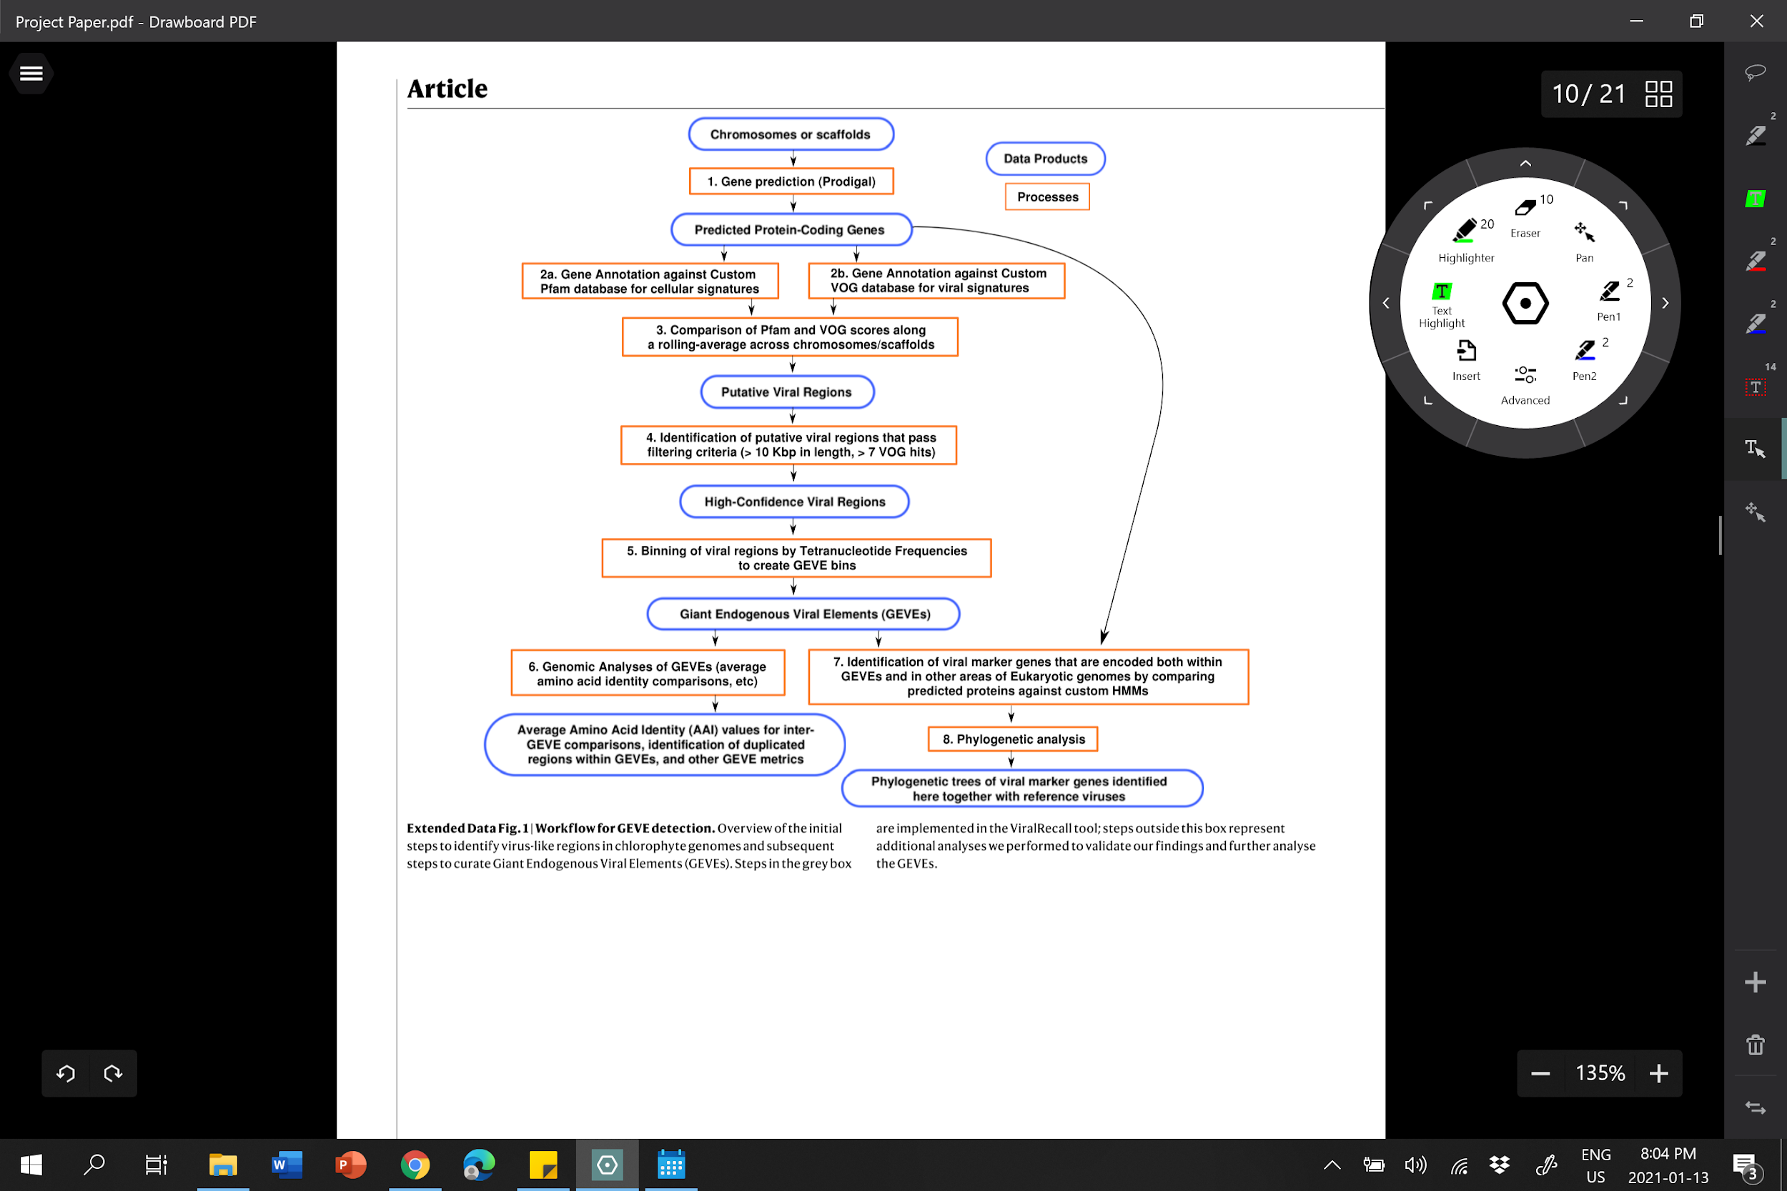
Order of Methodology According to the Paper
(Moniruzzaman et al., 2020)
Notes:
And the reason it took so long is because the paper wasn’t exactly clear in its delivery of the methodology section which step came when, and a lot of that I think comes from doing multiple steps in tandem - like say the HMM searches and the Homology searches. The authors provide a clear flow chart and we were hoping that we could at generally follow it, but we found that it wasn’t working well for us.
ViralRecall - identify possible giant virus genes in algae using Prodigal and VOG database, no intron-exon prediction
TNF binning - screening method to remove any potential false positives that may have occurred when accounting for changes that occurred in the nucleotide frequency during integration into host genome
Hybrid gene prediction - use AUGUSTUS to determine intron exon boundaries, keep only those prodigal-annotated genes that have no overlap with any AUGUSTUS predicted gene features - UTRs, introns, exons, etc
NCVOG HMM search - generate HMMs from reference giant virus genomes to aid in identifying GEVEs in algal genomes
Birpartite network analysis - visualize shared gene content between GEVEs and reference giant virus genomes
Homology search - phylogenetic provenance of GEVEs - searched predicted GEVEs from algal genomes for viral hits
Phylogenetic analysis - DNA polymerase and major capsid protein as hallmark genes for phylogenetic analysis of viral genes, phylogeny of hosts built with large subunit of rubisco protein
Intron density, intron sharing and other GEVE metrics - used to show that GEVE act in the same way as eukaryotic genes
So when we had this issue, we emailed the authors about it, as well as some other stuff regarding the hybrid gene prediction And what they told us indicated that the flow chart isn’t accurate to what they actually did.

Slide 5
Actual Order of Methodology According to the Authors
ViralRecall
Hybrid gene prediction
NCVOG HMM search
Bipartite network analysis of GEVEs
Homology search
TNF binning
Phylogenetic analysis
Intron density, intron sharing and other GEVE metrics
Notes:
So based on their email this is the actual sequence of steps, you can see that the TNF binning has moved to after the Hybrid gene prediction, NCVOG HMM searches and Homology searches.
(if asked: Bipartite analysis is the visualization of the NCVOG search)
ViralRecall - identify possible giant virus genes in algae using Prodigal and VOG database, no intron-exon prediction
Hybrid gene prediction - use AUGUSTUS to determine intron exon boundaries, keep only those prodigal-annotated genes that have no overlap with any AUGUSTUS predicted gene features - UTRs, introns, exons, etc
NCVOG HMM search - generate HMMs from reference giant virus genomes to aid in identifying GEVEs in algal genomes
Birpartite network analysis - visualize shared gene content between GEVEs and reference giant virus genomes
Homology search - phylogenetic provenance of GEVEs - searched predicted GEVEs from algal genomes for viral hits
TNF binning - screening method to remove any potential false positives that may have occurred when accounting for changes that occurred in the nucleotide frequency during integration into host genome. The authors told us that this was the correct sequence as evidence from NCVOG and Homology searches were needed to do this, but this was not reflected in the methodology given in the paper.
Phylogenetic analysis - DNA polymerase and major capsid protein as hallmark genes for phylogenetic analysis of viral genes, phylogeny of hosts built with large subunit of rubisco protein
Intron density, intron sharing and other GEVE metrics - used to show that GEVE act in the same way as eukaryotic genes

Slide 6
ViralRecall
First step in workflow
Author created
Prodigal predictions on algal genome compared to PFam and VOG databases (version 1) or PFam and GVOG databases (version 2)
Unable to replicate results reported in paper using just ViralRecall
Minscore = 1 not 10, authors confirmed
Version used in paper had lots of manual curation added to it
About ⅔ of results came from just ViralRecall
Notes:
ViralRecall was the first step in the workflow for the paper. Its a tool that the authors developed themselves and have since upgraded. It combines the use of Prodigal to predict genes in the algal genome in an intronless manner and then further curates the Prodigal predicted genes by comparing each predicted gene to hits to the PFam database (which is a database for eukaryotic genes) and the VOG database (which is a database for viral genes) and scores them by subtracting VOG scores from PFam scores, only scores that came in above the minscore are reported as possible GEVEs. Prodigal is used because it’ss meant for predicting bacterial and archeal genomes so its expected to underperform on actual eukaryotic genes and produce better results (better scores) for GEVEs.
Version 2 of ViralRecall uses the GVOG database (which is a database for giant viruses specifically) instead of the VOG to enhance the number of hits to giant virus elements that did not exist in the VOG database. Version 2 also has an option for switching between the VOG and GVOG databases.
We started running ViralRecall with the VOG database using version 2 of ViralRecall but were unable to replicate any results shown in the paper using just ViralRecall and we spent a lot of time trying to figure out why that was because the authors mentioned in an email that we didn’t need to worry about the manual curation because that’s in ViralRecall and he paper itself was kind of unclear on the minscores used - in one section they said they used minscore = 10 and in the flowchart from earlier they said they used minscore = 7 but we didn’t get any results until we tried lower minscores of 1. And we even considered trying to determine which github commit was from Verison 1 so we could try using that instead.
We had the authors clear that up for us in a recent email that the minscore should be 1 as we had found because in version 2 the minscores are square root transformed so using minscore 10 as they did in the paper using version 1 of viralrecall would eliminate most if not all results.
Moreover, the results from Version 1 were heavily manually curated using other analysis tools including checking the predicted gene loci for virus hits using BLAST, and looking for hits to a set of 10 hallmark genes in the predicted loci and that only about ⅔ of their reported contigs came from viral recall itself and not their manual curation. Thus they told us that it would best to continue to use version 2 of viral recall because we were at least getting similar proportions of results that they did and that most of their work on the paper used the large contigs that were obtained from viral recall, which we also obtained in our results.

Slide 7
Hybrid Gene Prediction
Notes:
Prodigal is a gene-finding program for microbial genomes with a high sensitivity (less false positives). AUGUSTUS is a statistical gene finding tool for finding eukaryotic protein-coding genes and their intron-exon structure in genomic sequences
Both are ab initio methods.
As Prodigal focuses on predicting intronless prokayotic genes and is robust for predicting viral genes as well but is bad at predicting the more complex eukaryotic genes. In the same vein, AUGUSTUS predicts eukaryotic genes but will underpredict viral regions. Both used are used in tandem in the Giant Virus paper to find endogenous GEVE regions in algal genomes.
For viral genes that may have picked up introns themselves, the NCVOG Hmm search takes that into account but its not something that is addressed during hybrid gene prediction.

Slide 8
Combination Script
Hybrid gene prediction is specific to this paper -
custom script required to combine Prodigal and AUGUSTUS predictions
All AUGUSTUS predictions are kept and only non-overlapping Prodigal predictions are retained
BioPython’s SeqIO and BCBio’s GFF modules used to compare AUGUSTUS and Prodigal results
Notes:
The combining of the Prodigal and AUGUSTUS results is highly specific to this project and done via a small python script. In the paper it says that hybrid gene prediction is combines all the AUGUSTUS predictions with any Prodigal predictions that have no overlap with the AUGUSTUS predicted features, the authors further clarified this in a previous email to explain that partial overlaps are considered part of the AUGUSTUS prediction and therefore those Prodigal predictions are not added to the hybrid gene predictions.
I set up a python script using BioPython because while I could have just treated the gff files as a tsv file in Python, BioPython has a module for working with gff files and a module for sequence features which made comparing the locations of each feature easier. SeqIO has a location object that has an “in” comparison that allows me to check if the start or stop of the Prodigal prediction falls within the AUGUSTUS predicted gene sequence. And the GFF module made checking each feature easier as I didn’t have to traverse the entire file line by line multiple times since when the GFF module parses the file it groups all the features for each contig together. Thus, instead of traversing the entire AUGUSTUS file I could simply check which contigs matched and if the predictions came from the same contig then I search each Prodigal predicted gene from that contig against all the AUGUSTUS predicted genes from that contig.

Slide 9
AUGUSTUS
Keystone to hybrid gene prediction
predicts intron-exon boundaries in genes
Which Prodigal results are kept depends on AUGUSTUS results
Difficulty recreating gene predictions for AUGUSTUS
Too few results
High sensitivity to flag setting
Notes:
This was the most important part of the hybrid gene prediction step. AUGUSTUS is a eukaryotic gene prediction tool so this is where all of the intron-exon boundary prediction happens. Given that the authors were taking a hard stance on what constituted as eukaryotic sections of the gene by removing any Prodigal results that overlapped with AUGUSTUS results and kept ALL their AUGUSTUS results, the AUGUSTUS gene predictions are the keystone to the Hybrid Gene Prediction step. Which makes it unfortunate that this is also where we had the most trouble in predicting genes.
So we mentioned before that the trouble we had with AUGUSTUS is that we just weren’t getting the correct results and that the results we were getting were very sensitive to the flags, specifically we weren’t getting the correct number of gene predictions. When we emailed the authors about it we were told that the complete option for the genemodel was probably the cause as it would be removing partial genes at the ends of the contigs. I found that I got the best results when working with default settings - having set the training model to C. reinhardtii and genemodel to partial.
Using those settings I was able to more or less replicate the AUGUSTUS results reported in their combined hybrid gene predictions file.

Slide 10
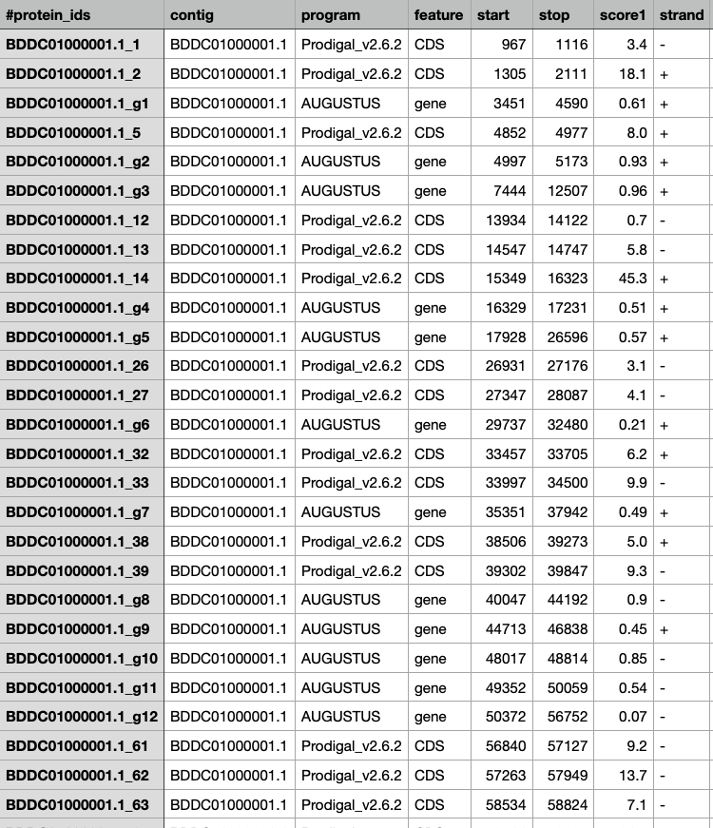
Hybrid Gene Prediction Replication for C. sphearoides
Author’s Provided Files for Hybrid Gene Prediction in C. sphaeroides
My output for Hybrid Gene Prediction in C. sphaeroides
Notes:
So this is a side by side comparison of my combined results for the hybrid gene prediction in regards to the authors’. So as you can see, my results for C. sphaeroides matches up almost perfectly with the authors’ results now. This section matches up perfectly with the authors’ but some other genes further down are a little wonky in the exact locations of the AUGUSTUS gene predictions but only by a few base pairs, but overall I think I successfully replicated the hybrid gene prediction step.

Slide 11
References
Moniruzzaman, M., Weinheimer, A. R., Martinez-Gutierrez, C. A., & Aylward, F. O. (2020). Widespread endogenization of giant viruses shapes genomes of green algae. Nature, 588(7836), 141-145. doi:10.1038/s41586-020-2924-2

